Slide 1


Large Language model for B-Cell Clonotyping
Alos Diallo

Slide 2
Why are we interested?
To understand the development of our immune system from infection or vaccination, we first need to study how individual antibody species are evolving over time
Understand the biology of B-cell mutation
Look at B cell sequences, as B cell affinity mature against their target antigen, they acquire somatic hypermutation which enables them to more strongly bind to their target
How do we determine B-cell lineage?
We need a way to determine what mutations are the result of affinity maturation from a single B cell lineage as antibody sequences may look similar
Hope to get a better sense of immune response from the perspective of B-cells
We can understand the diversity of the B cell repertoire against a given target, which helps us evaluate the breadth of the response which can be critical when encountering a different variant of a viral antigen (e.g., only a small portion binds to preserved residues would continue to bind)
By grouping antibody sequences into clonotypes (B cell sequences with presumably the same evolutionary lineage), we are able to better understand how antibody sequences have evolved over the course of previous exposures, those mutations can inform us on how to elicit antibodies with desirable properties (i.e., engineering a better vaccine)
NOTE: I got help from Nick on this ☺

Slide 3
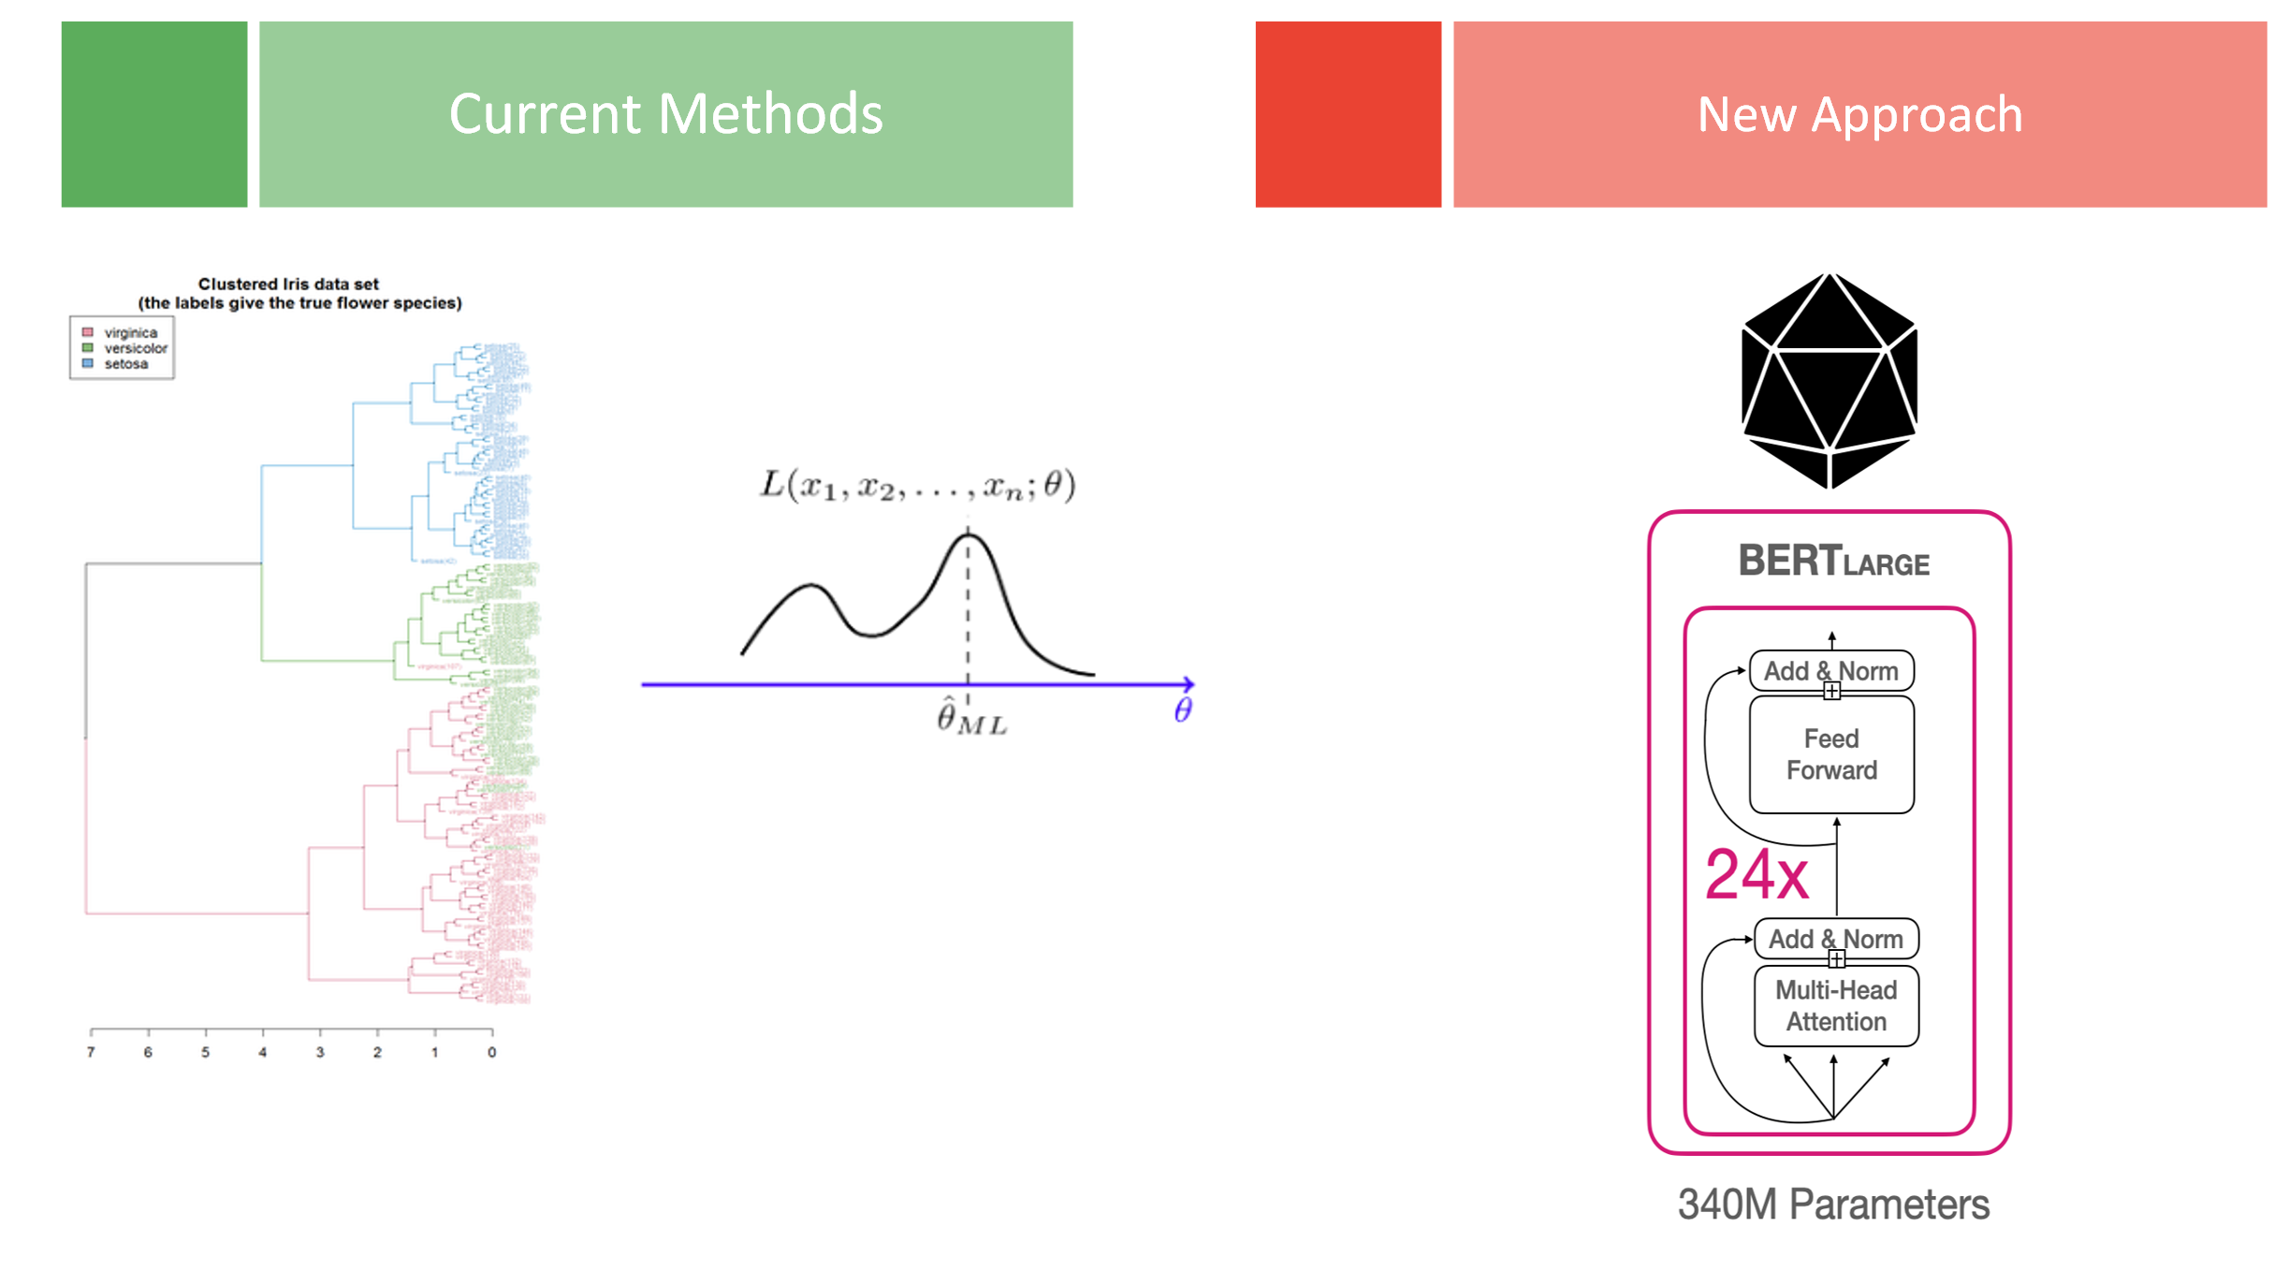
Current vs New Approach
Current Methods: MLE, Heuristic, Hierarchical Clustering
Drawbacks:
Inflexible
Can’t consider multiple types of data
Doesn’t scale
No pre-train ability
Advantages:
Speed
Ease of Interpretability
New Approach: Neural Network (Transformers)
Drawbacks:
Time consuming to train and configure
Advantages:
Flexibility in types of input
Can be pre-trained on large datasets
Scales

Slide 4









































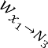







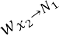











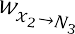




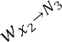


Artificial Neural Network
Weights
Input Layer (Layer 1?)
Hidden Layer (Layer 2?)
Output Layer (Layer 3?)
Input Data
Output Data

Slide 5

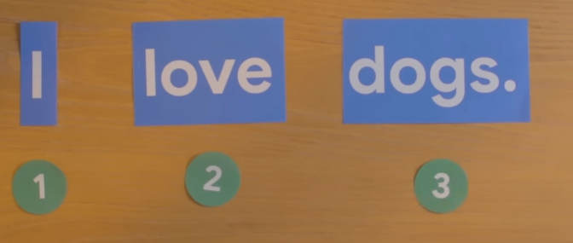
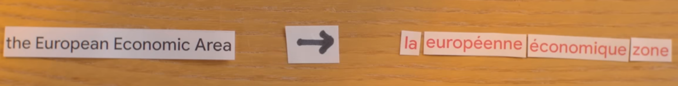
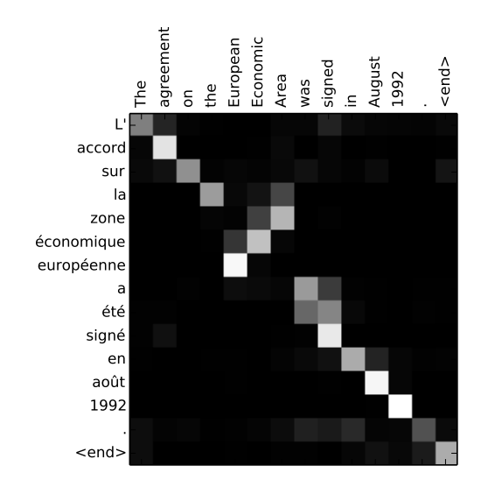
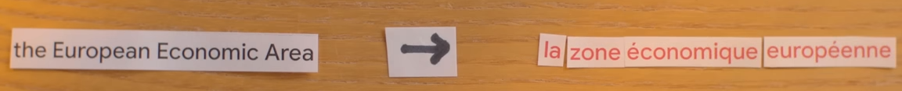
Transformers
Positional Encoding:
Give each word a value indicating its position in a sentence, Store that information with the word.
Attention: A matrix structure that looks at every other word in the original structure before translating the work into the new structure
Hasbro
Google

Slide 6
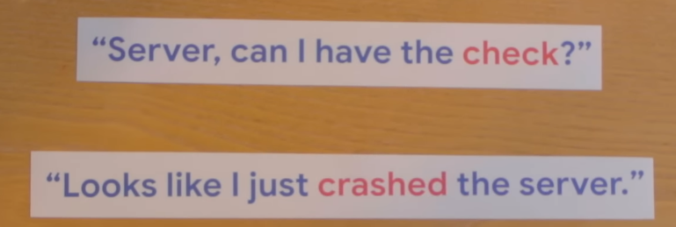
Transformers
Self-Attention:
If you want to know the underlying meaning of words, you need to understand words by looking at the context of the words around it.
In this example, “server” means two different things. Therefore, understanding the context of the words surrounding our word of interest allows us to make better predictions.
Hasbro
Google

Slide 7
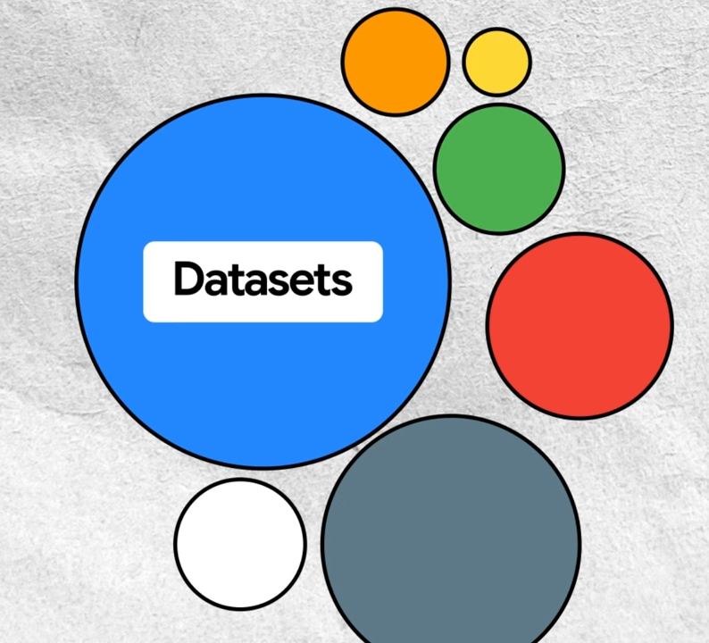
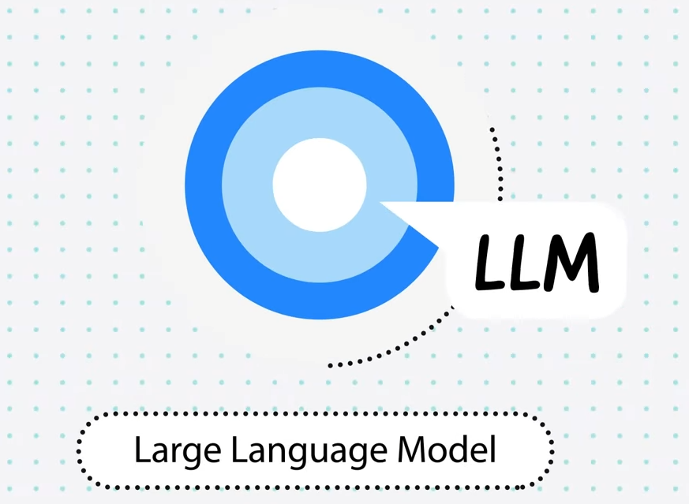
Google

Slide 8

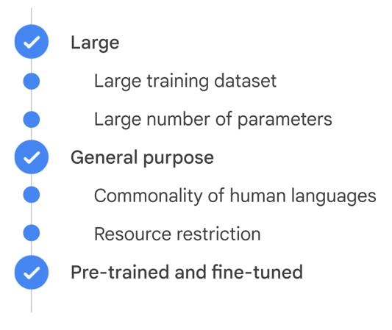

Large Language Models
Google

Slide 9
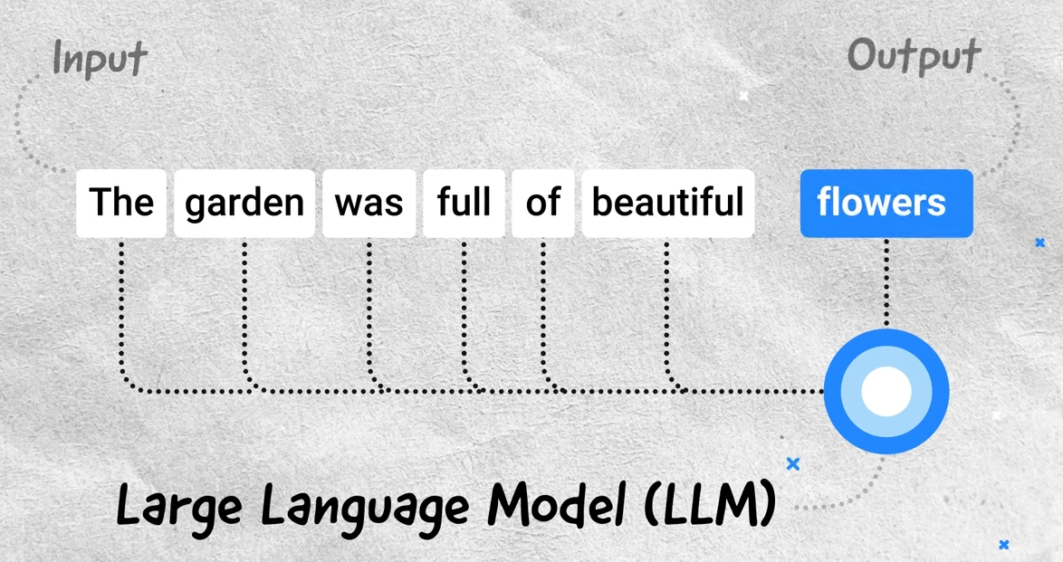
How do LLM’s Work?
Google

Slide 10
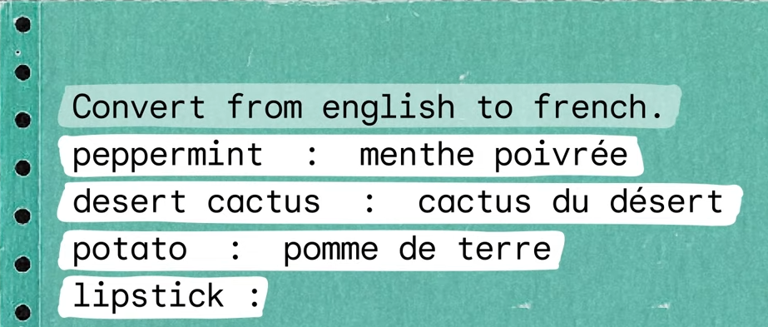
Prompt
Google

Slide 11
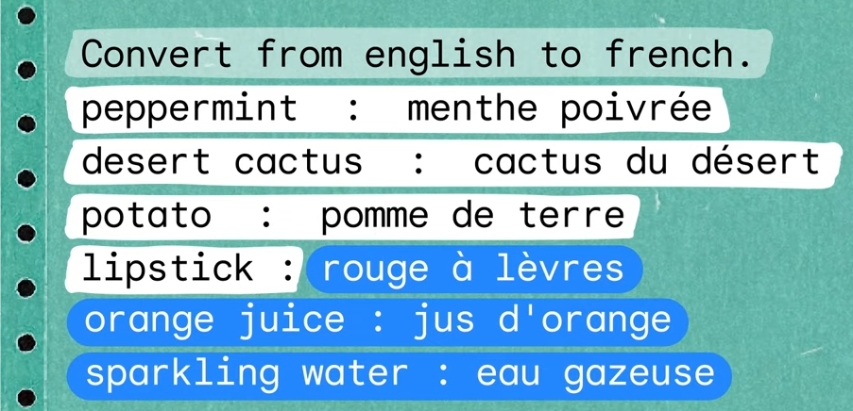
Output
Google

Slide 12

The models
Version 1: Protein-BERT
Trained on 106M proteins derived from UniProtKB/UniRef90, covering the entire tree of life
Version 2: nucleotide-transformer-2.5b-multi-species model
DNA sequences from over 3,200 diverse human genomes, as well as 850 genomes from a wide range of species, including model and non-model organisms.
Hugging Face, PBS, Google

Slide 13
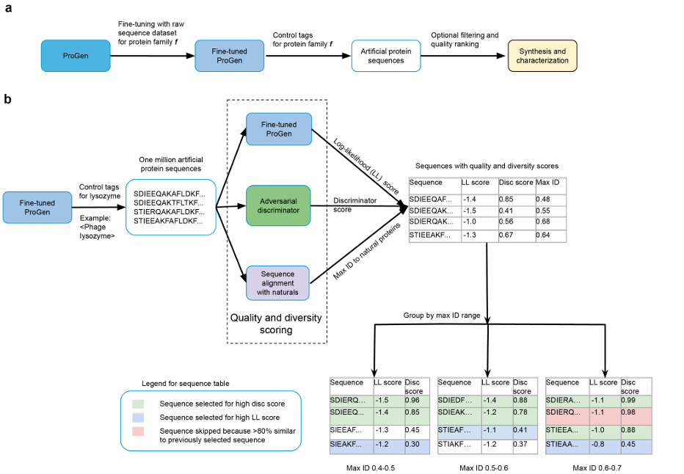
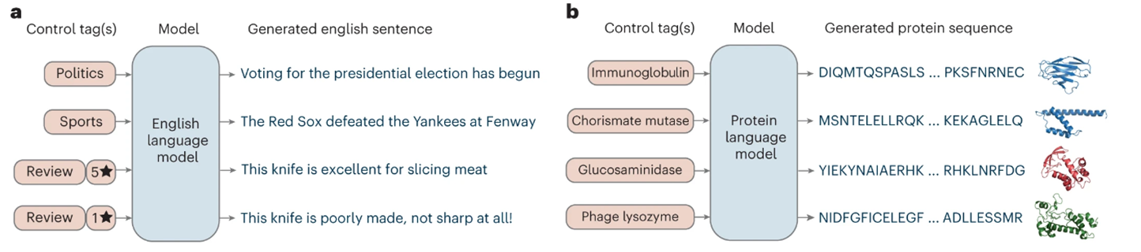
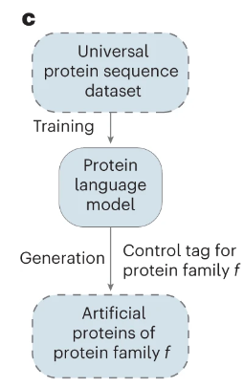
LLM Bert Example
Ali Madani et. al.

Slide 14
Dataset
SARS-CoV-2 convalescent patient (child)
7000 B cells sequences (Heavy Chain)
Tonsils
Adenoids
PBMCs
10x Genomics V(D)J sequencing
filtering
UMIs with only 1 heavy chain read
maximum of 1 light chain read
Input cells sorted by FACS
33% SARS-CoV-2 S1/RBD positive
67% SARS-CoV-2 S1/RBD negative
IGHV SHM
calculated using MiXCR with an IMGT germline reference database.
IMGT is the collection of known germlines antibody gene sequences, these are aligned with MiXCR software which will calculate a somatic hypermutation rate based on the difference from the germline genes

Slide 15
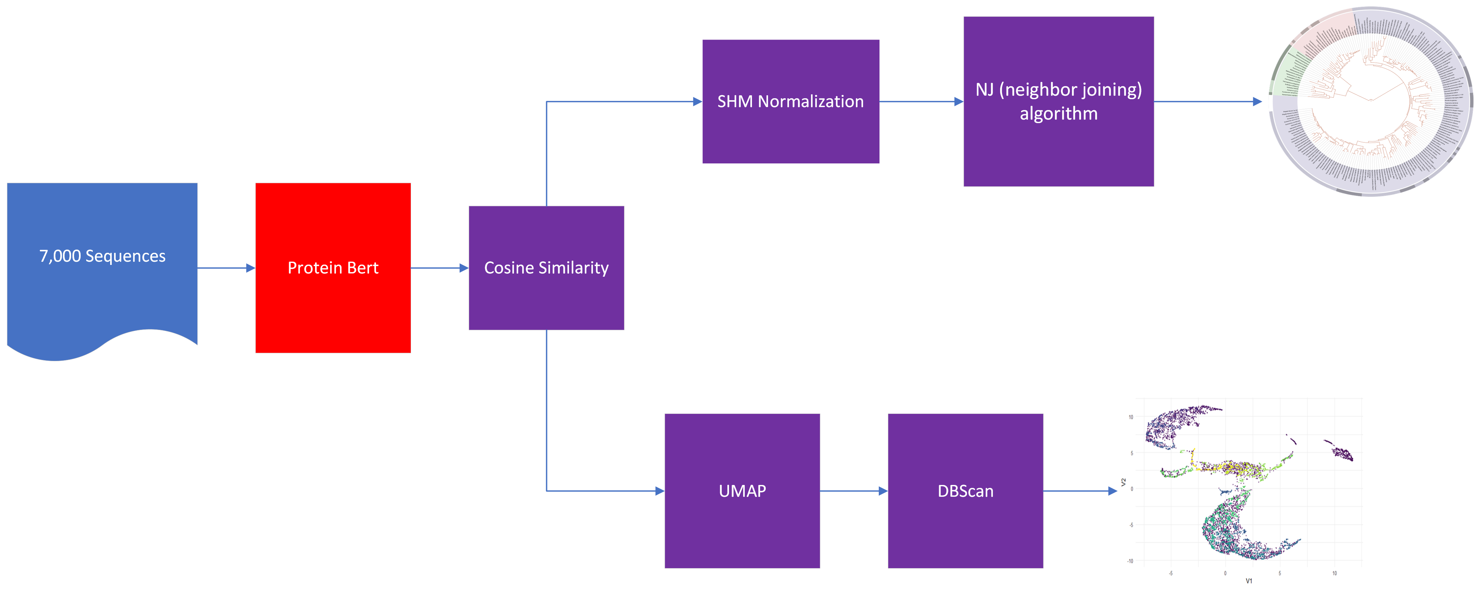
Version 1 - Workflow
Part 1
Part 2

Slide 16
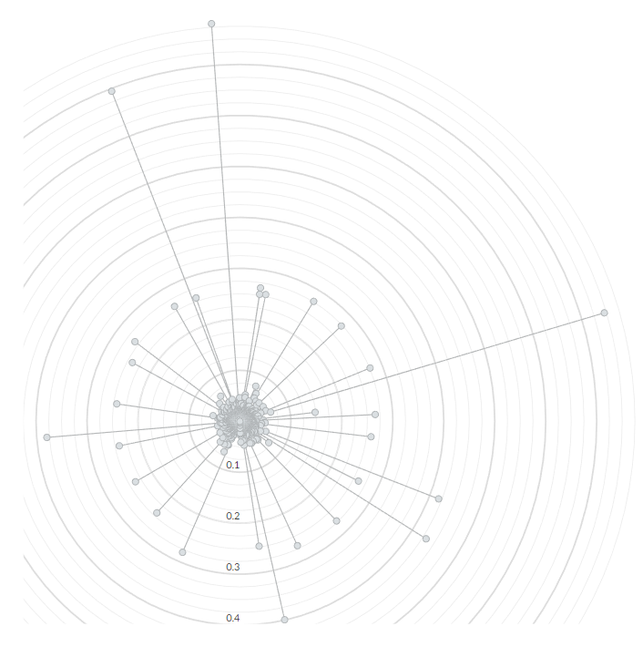
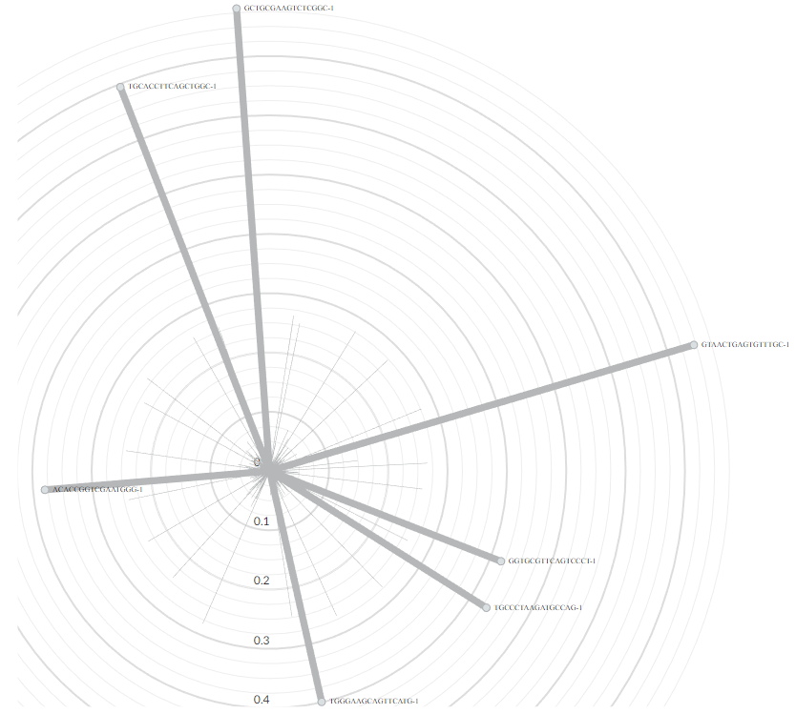
Phylogenetic Tree
GCTGCGAAGTCTCGGC-1
TGCACCTTCAGCTGGC-1
GTAACTGAGTGTTTGC-1
ACACCGGTCGAATGGG-1
GGTGCGTTCAGTCCCT-1
TGCCCTAAGATGCCAG-1
TGGGAAGCAGTTCATG-1

Slide 17
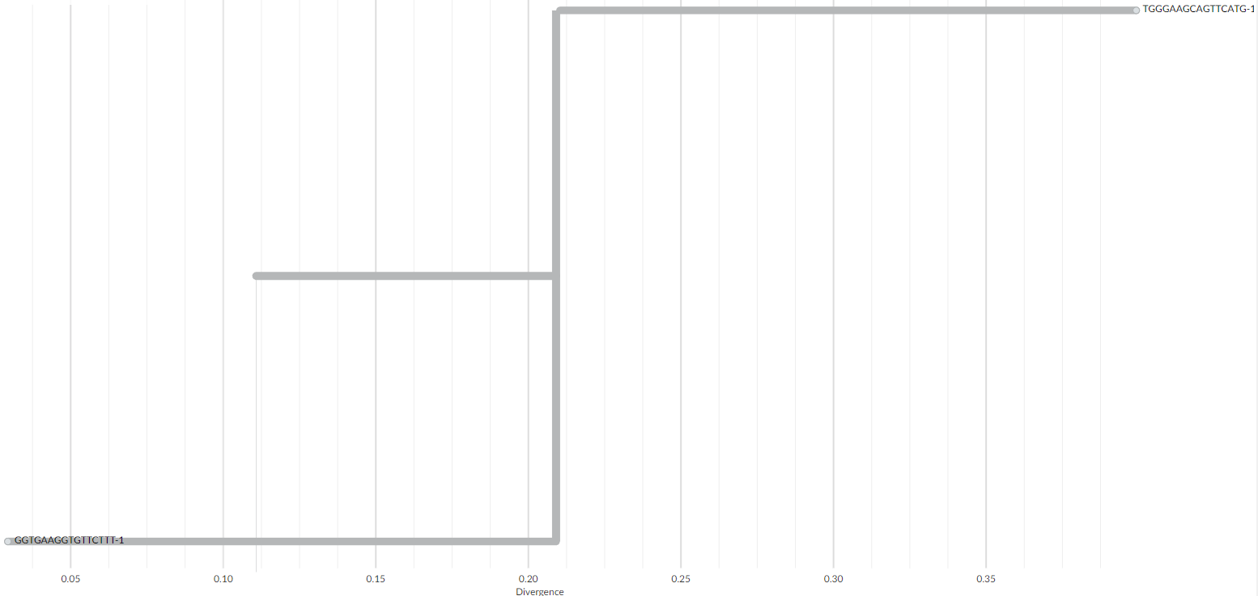
Phylogenetic Tree

Slide 18
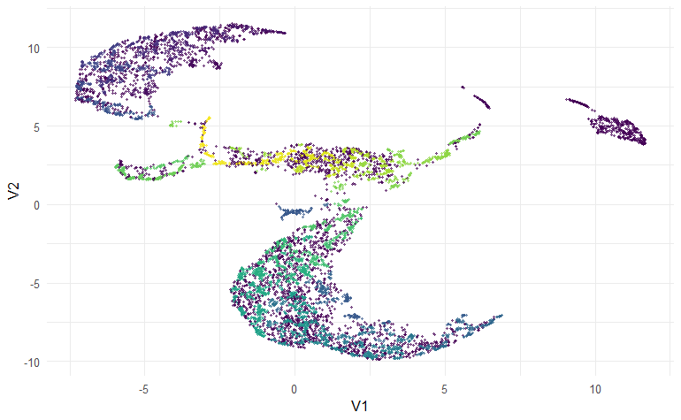
Clustered Embeddings

Slide 19
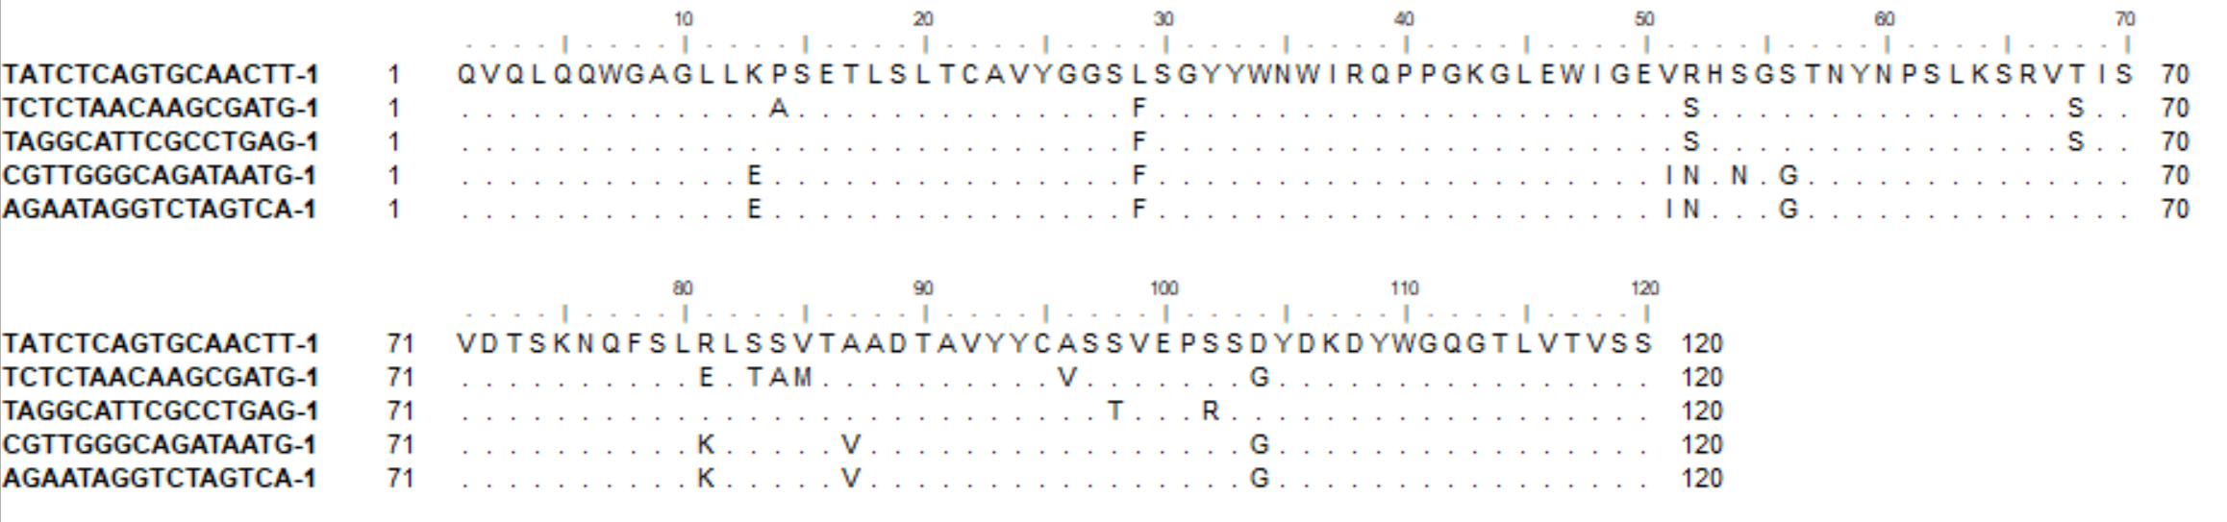

Clustered Embeddings
Examples of sequences which are clonally related, and in the same cluster.

Slide 20
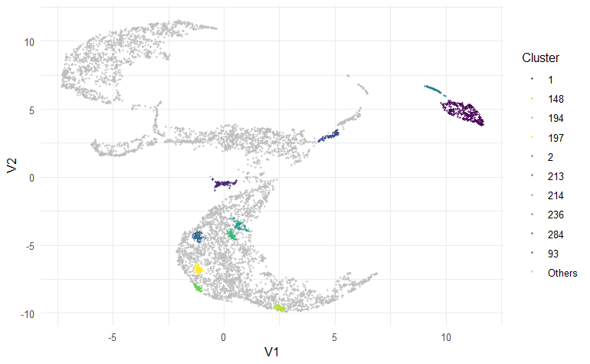
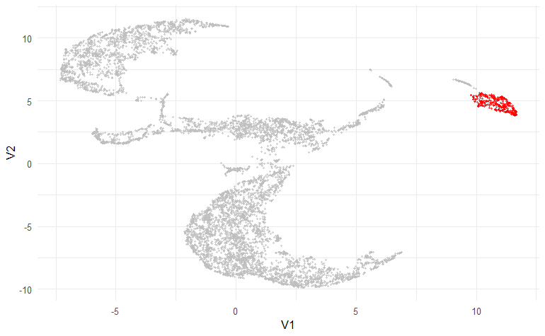
Clustered Embeddings
Top Cluster
Top 10 Cluster

Slide 21
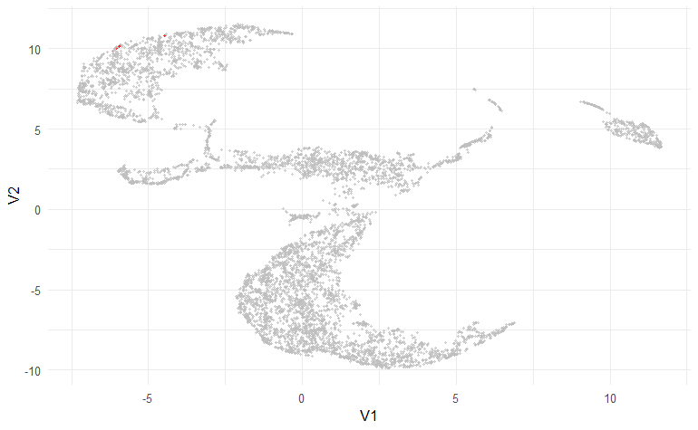
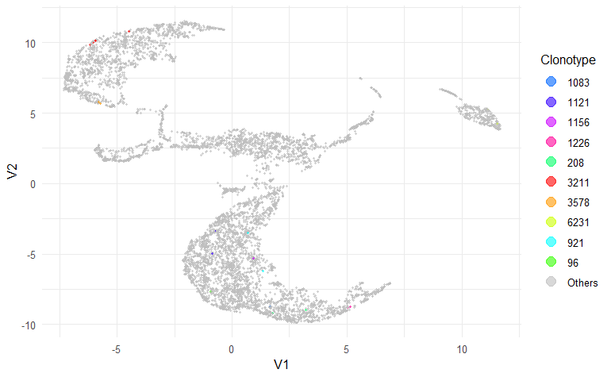
Clustered Embeddings
3211
Top 10 Clonotypes

Slide 22
Version 1 - Issues + Current Limitations
Resource Intensive
Building the tree
60gb of ram for 7000 sequences
10 cpu cores
20 hours – per run (each change)
Generating the UMAP and running DBScan
40gb of ram for 7000 sequences
8 cpu cores
Interpretability
The tree can be hard to interpret due to its size

Slide 23
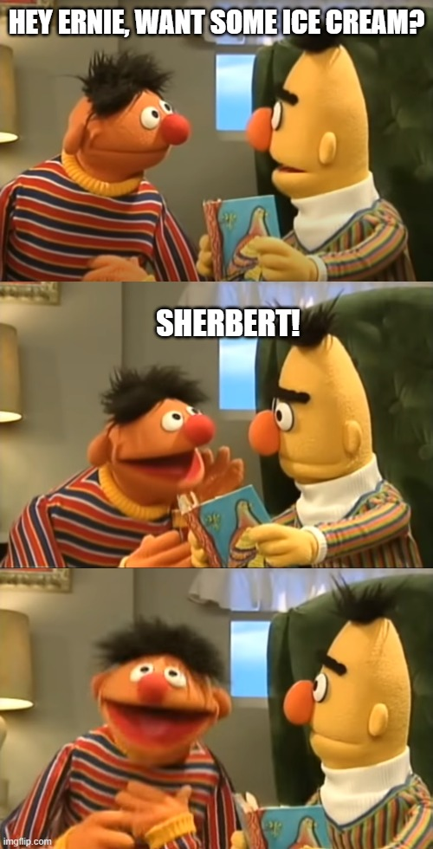
Next Steps
Use more robust input sequences
Convert the script from CPU to GPU driven
Right now, the code only uses CPU’s due to ease of testing
DNA trained language model
Incorporate
the Heavy and Light chain
Sequence Length
The specific gene name
Complementary determining region 3 on the heavy chain (CDR-H3)
Charge
PBS

Slide 24
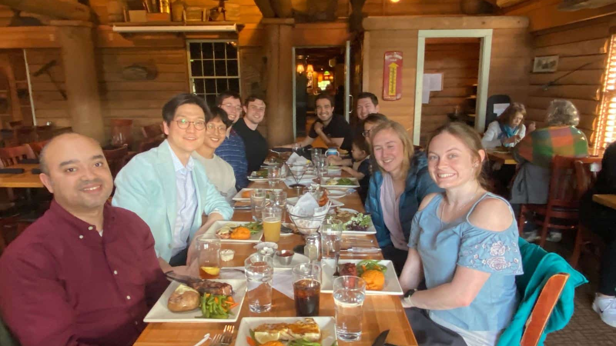
Thank you

